Slide 1


Slide 2
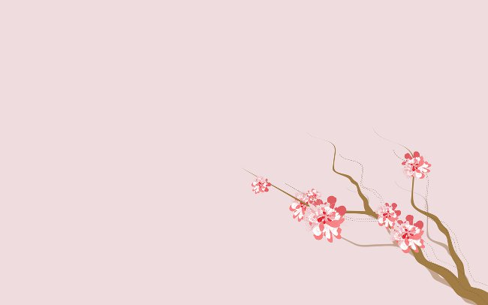




Topic : Dong Ho painting
Member : Nguyễn Vương Trà My Trần Phạm Thái Hân Trần Công Minh Trịnh Vũ Việt Nam

Slide 3


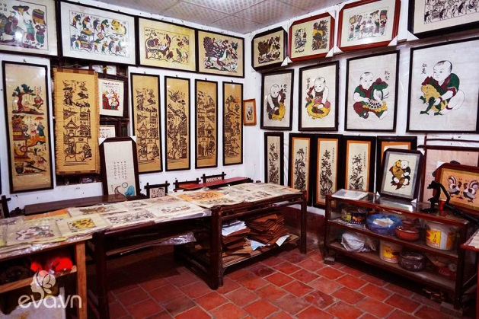
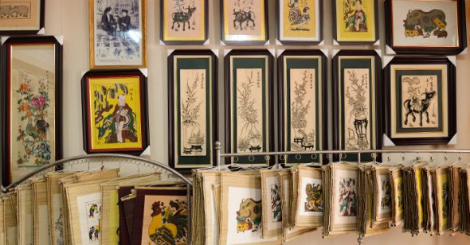
What is Dong Ho painting ?
- Full name: Dong Ho folk wood painting. - It is a Vietnamese folk paintings with Origin from Dong Ho Village (Bac Ninh) . - Previously the paintings were sold mainly to serve on the occasion of the Lunar New Year. - Dong Ho folk paintings are recognized by UNESCO as an intangible cultural heritage.

Slide 4

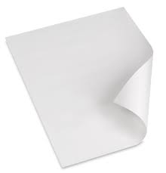
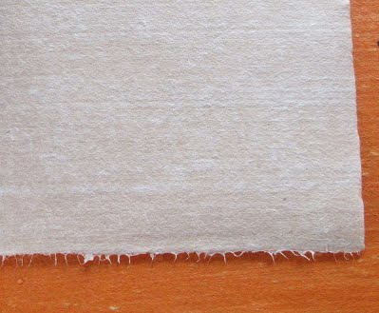
Printing paper and colors of Dong Ho paintings
- Dong Ho picture printing paper is called scalloped paper.
- People crush the scallops shell, a thin shell of shellfish in the sea, mixed with the lake (the lake is made from glutinous rice flour, or sticky rice, sometimes cooked with cassava flour - glue used to sweep the picture is usually diluted from glutinous rice flour or tapioca, glutinous glutinous rice paste is commonly used for paste) - And then the pine leaf brush is applied to the paper.

Slide 5



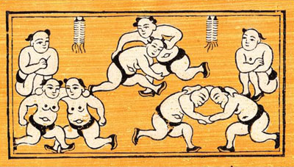
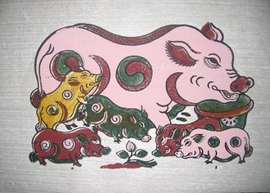
Changes to the old times
- Dong Ho painting is quite close to the majority of Vietnamese people. It is close because its image has entered poetry and literature in the general education program. - Dong Ho prints at the present time often do not have the deep colors like ancient paintings used in industrial colors, the new version has not been as refined as before.

Slide 6


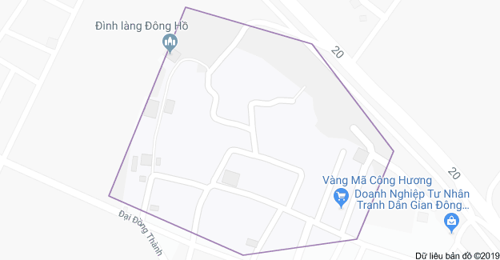
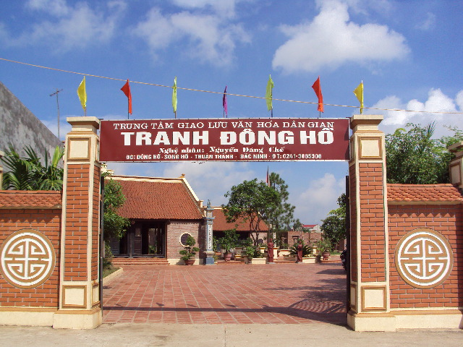
Dong Ho village
- Is the famous craft village of folk painting, Song Ho commune, Thuan Thanh District, Bac Ninh Province. - A traditional ancient village has a history of 400 years - Dong Ho Village also known as the roof village. Year round lots of overseas tourists to Dong Ho painting village visit and buy Dong Ho paintings as anniversary.

Slide 7

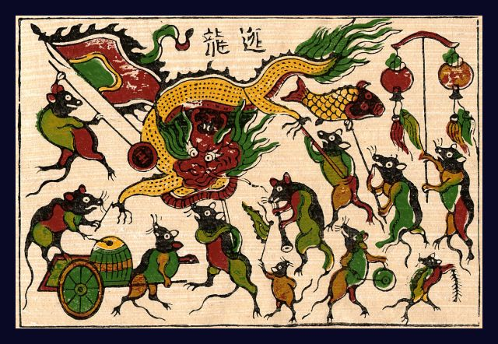
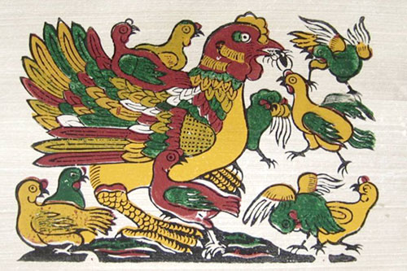
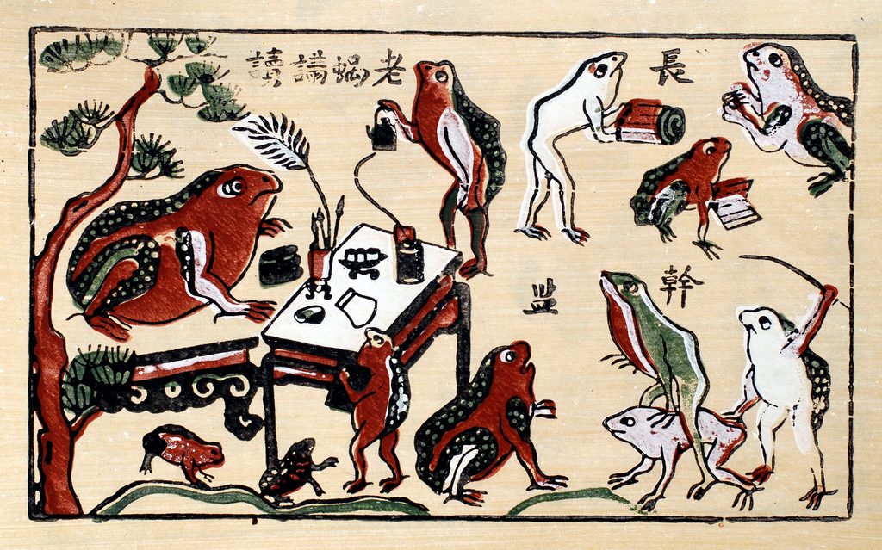
Some pictures of Dong Ho paintings

Slide 8

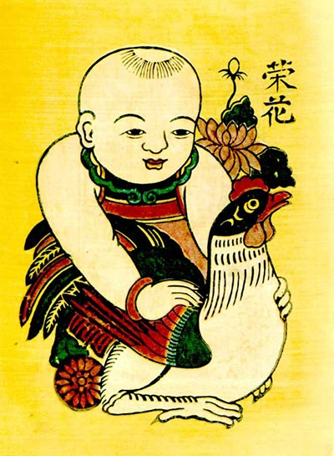
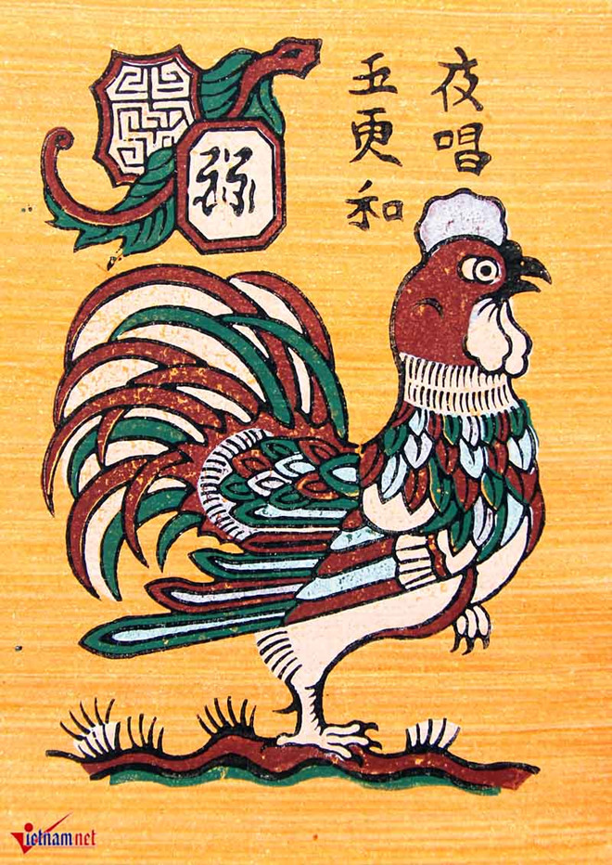
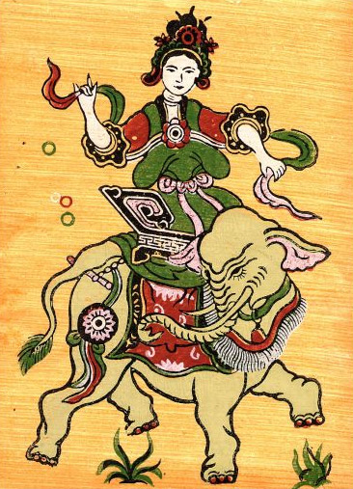
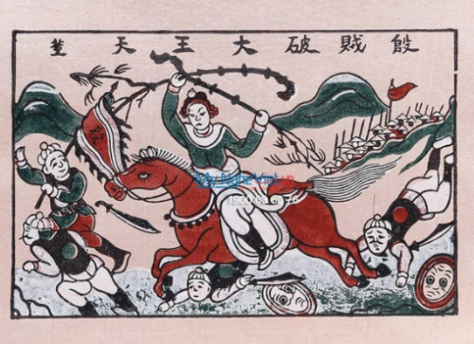

Slide 9


